Slide 1


Machine Learning Capstone Project
This presentation outlines a machine learning capstone project. It covers the entire ML pipeline. From business problem to model deployment, we will see each stage. We will explore data, build models, and refine performance.
By
Name Surname1
Name Surname 2

Slide 2
Defining the Business Problem
Clear Objective
Impact Measurement
The project aims to solve a real-world problem. It provides actionable insights for businesses.
Success is measured by key performance indicators. These KPIs align with business goals and value.
We clearly define the business problem early. This ensures that the project remains focused. The problem must have real world impact.

Slide 3
Planning and work division
How did you approach the problem?
How was work divided?
Highlight any collaboration work done

Slide 4
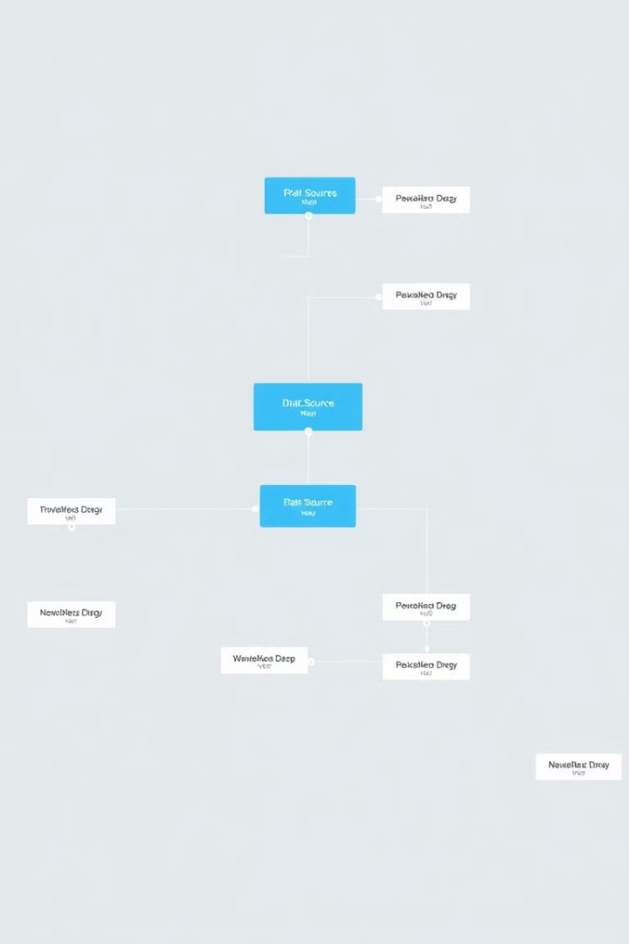
Data Understanding and Collection
1
Data Sources
Identifying relevant data sources is critical. We need to ensure data quality and availability.
2
Data Profiling
Understanding data types and distributions is important. This helps guide feature engineering decisions.
3
Data Collection
We establish a reliable data pipeline. This ensures consistent and accurate data for modeling.
We gather and profile the data. Understanding its characteristics is key for further steps.

Slide 5

Data Cleaning and Preparation
Handling Missing Values
Outlier Detection
Strategies for imputation are crucial. We need to address missing data appropriately.
Identifying and handling outliers improves model robustness. This helps prevent skewed results.
Data Transformation
Scaling and normalization techniques are used. These help optimize model training and performance.
Data cleaning ensures quality and consistency. Prepared data is essential for reliable modeling.

Slide 6
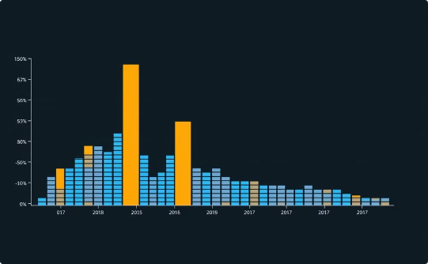
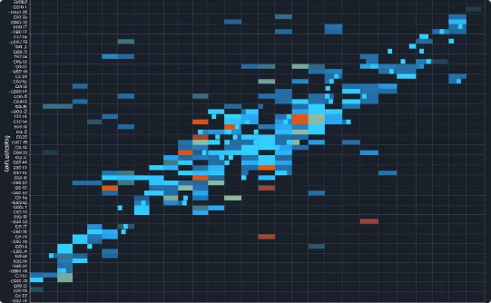
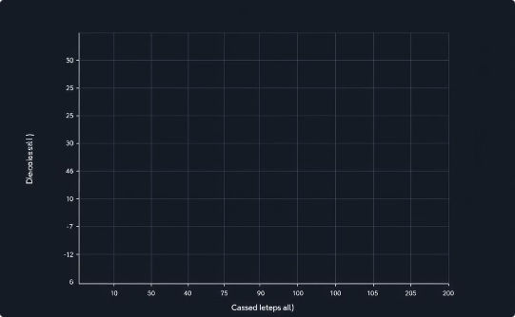
Exploratory Data Analysis (EDA)
Visualizations
Correlations
Data Transformation
Histograms and scatter plots reveal patterns. We want to understand relationships in the data.
Heatmaps show feature correlations. This helps identify potential multicollinearity issues.
Log transformations address skewed distributions. We want to improve model accuracy.
EDA uncovers insights. Visualizations guide feature selection and transformation.

Slide 7




Model Selection and Training
Algorithm Choice
Selecting the right algorithm is critical. Consider the data and problem characteristics.
Training Data
Splitting data into training/validation sets is key. This prevents overfitting and ensures generalization.
Model Training
Adjusting hyperparameters optimizes model performance. Focus on achieving desired outcomes.
We carefully choose and train the model. Proper training ensures strong predictive power.

Slide 8



Model Evaluation and Tuning
2
Hyperparameter Tuning
1
Evaluation Metrics
Validation
3
Metrics guide model refinement. Tuning improves generalization performance on new data.

Slide 9
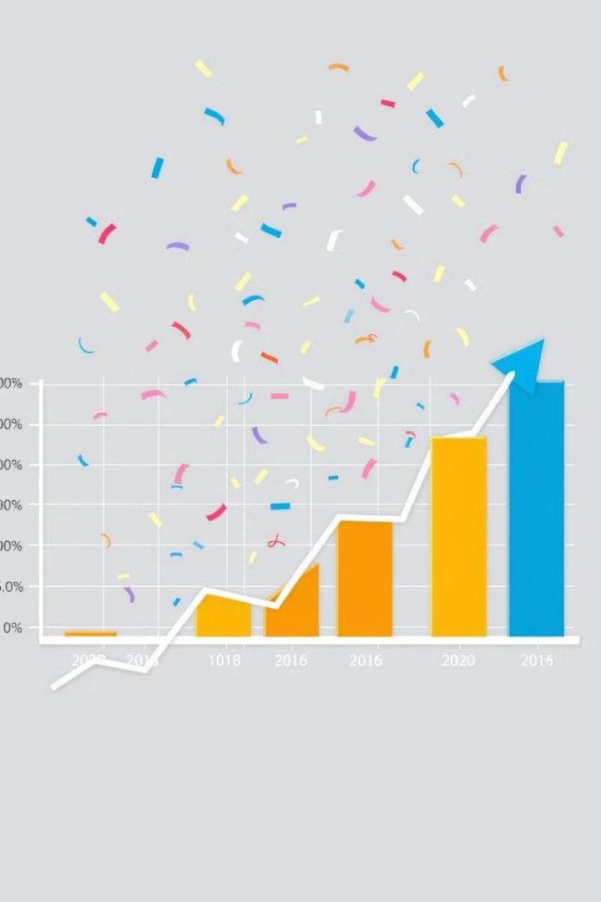
Final Results and Conclusion
95
Accuracy
Achieved after tuning
20%
Improvement
From baseline model
The project demonstrates significant improvement. This project solved the business problem. The model's performance is successful.

